Slide 1
Room Cleaning
Michael Han, Nicholas Han

Slide 2
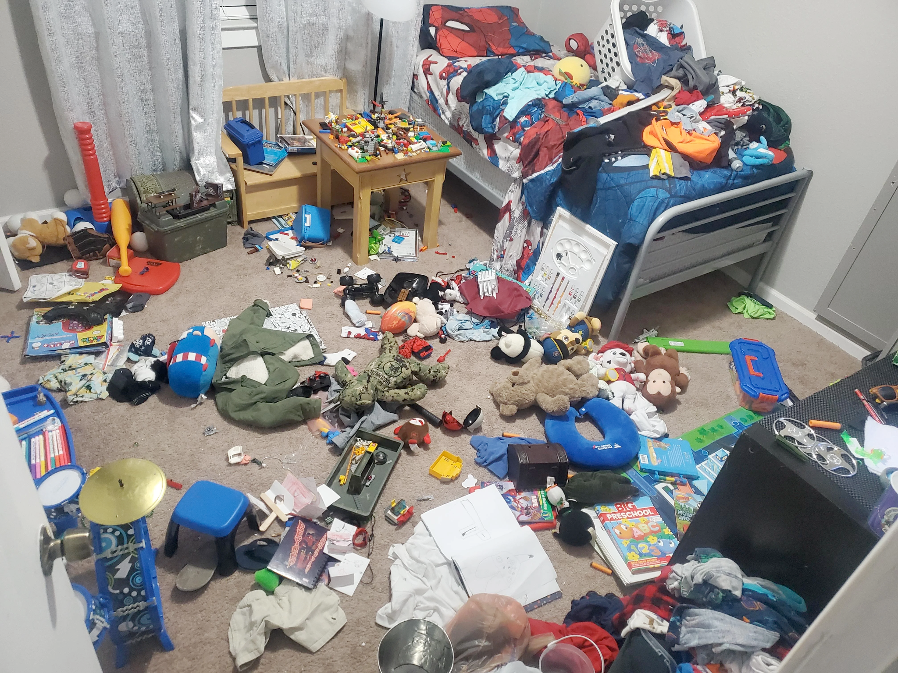
Motivation
A cluttered environment can contribute to feelings of stress, anxiety, and lowered mood.
The ability to quickly visualize a messy room as clean can be helpful for motivating someone to clean it up or motivate them to clean it up.
For real estate, it’s useful to remove unwanted items from scenes to help convince potential buyers or tenants more easily.
Hypothetically, if someone’s parents wanted a picture of their living space for proof that they can keep it clean and handle themself, it would be useful to be able to “clean” it quickly.

Slide 3
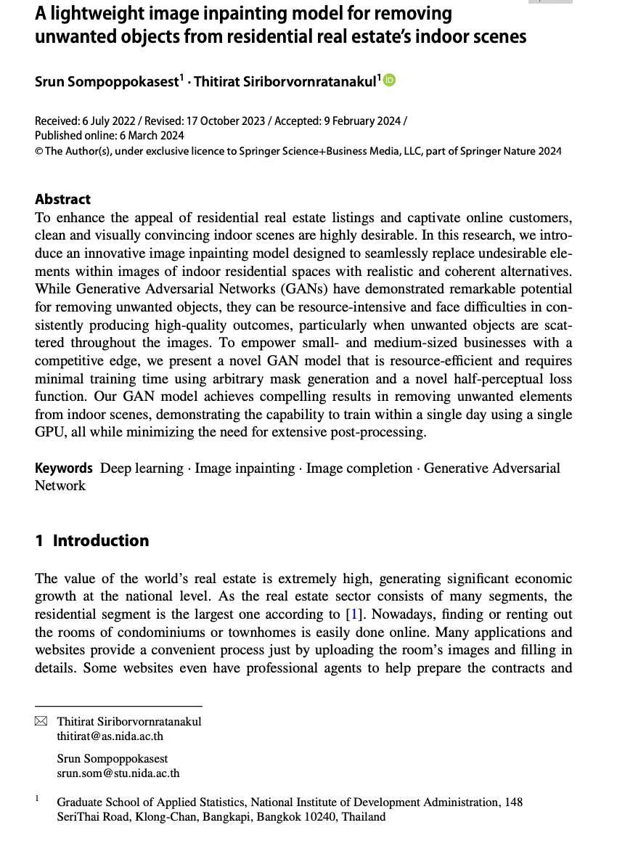
Related Work
Previous work on clutter removal uses GANs to inpaint clutter areas, combined with custom masks for said clutter areas. Although GANs are resource-intensive, the model proposed in the paper has the capability to train within a single day using a single GPU and is efficient.

Slide 4
Approach
Train an object detection model on images of messy rooms, identifying messy areas/objects.
Based on the parts of the room classified as clutter, create masks of the image.
Use inpainting to fill in the masked areas, removing all objects identified as clutter.

Slide 5
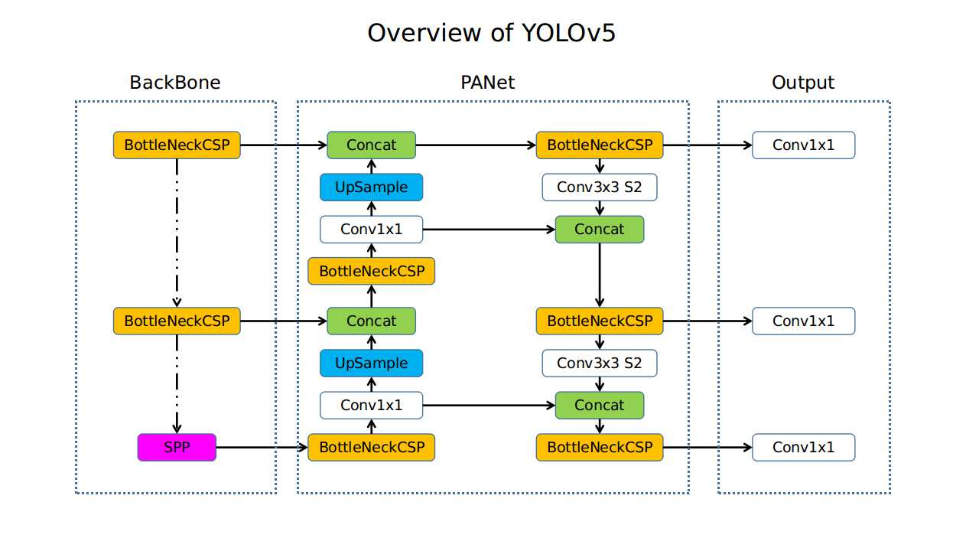
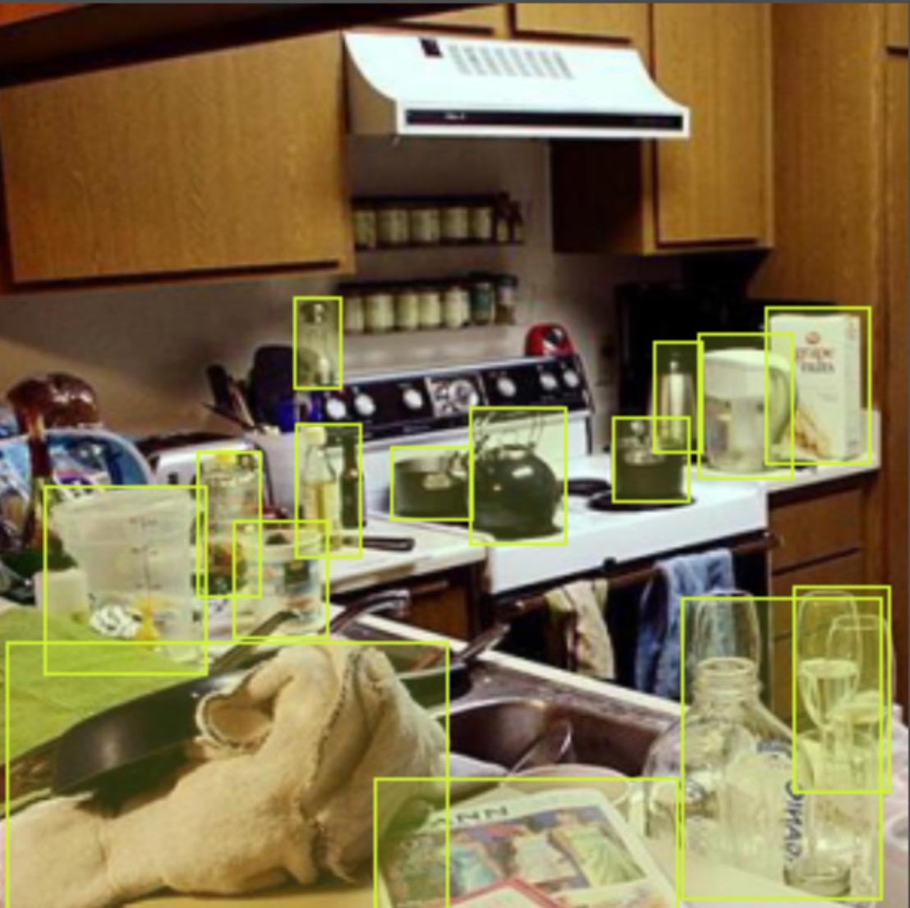
YOLO
YOLO, “You Only Look Once”, is an object detection algorithm that can detect objects in an image in real time efficiently using CNNs. Unlike two-shot object detectors like R-CNN and its variants, which first propose regions and then classify them, YOLO directly predicts class labels and bounding boxes of objects in a single pass. It is a single-shot object detector.
Used a YOLOv5 model that was pretrained on a large dataset for general object detection. Then, we fine-tuned on a smaller dataset of messy room images. For training, each image was manually labeled by adding bounding boxes around anything we considered clutter.

Slide 6
Inpainting
We used the Stable Diffusion v2 Inpainting model, which is a Latent Diffusion Model that uses a fixed, pretrained text encoder, to remove clutter from masked regions.

Slide 7
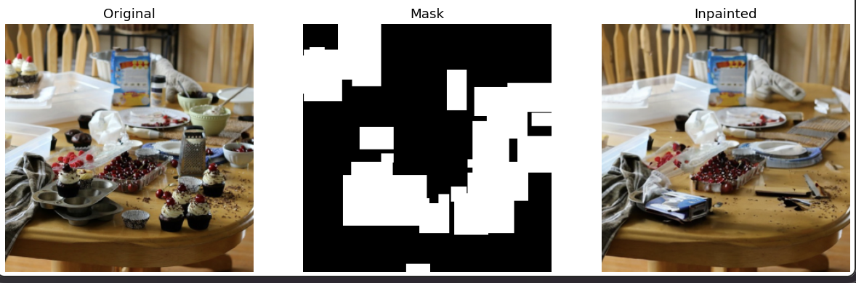
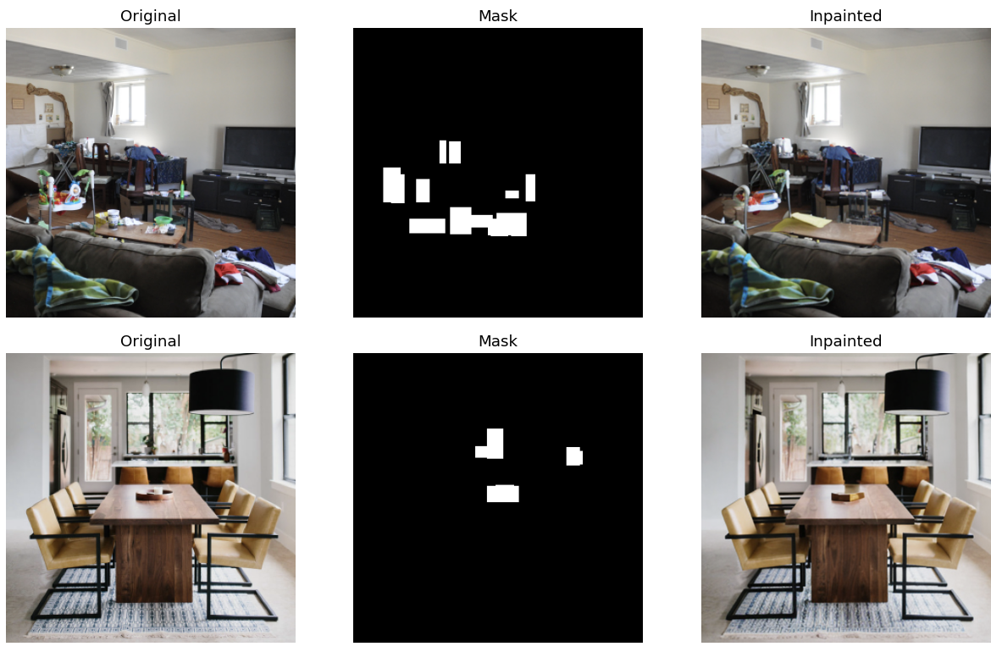
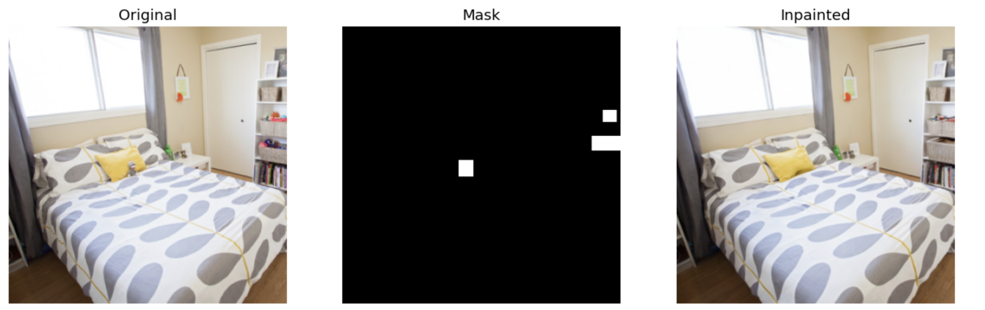

Slide 8
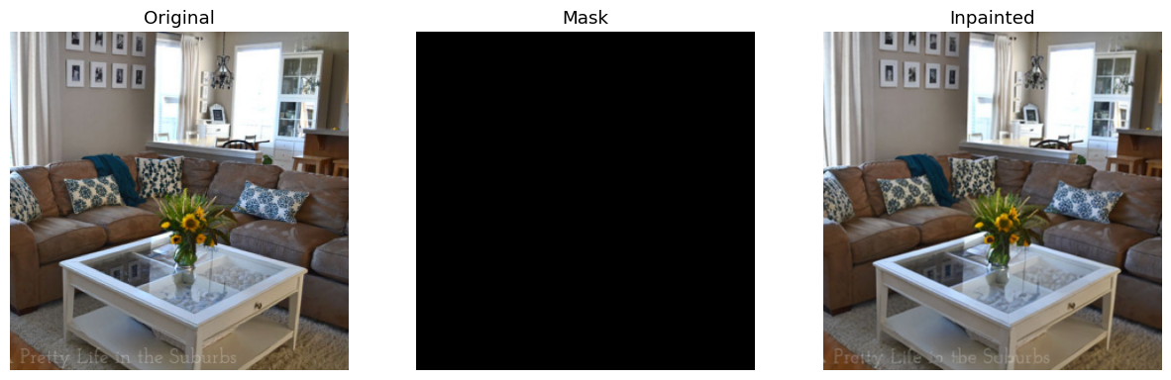

Slide 9
